Slide 1
Adversary Simulation
Combining the best of Audit and Penetration Testing

Slide 2
What is an adversary simulation?

Slide 3
What is an Adversary Simulation?
The concept became common during 1960’s military war-game exercises
Red Team + Blue Team = Purple Team?
Threat Emulation
Threat Hunting
Adversary (ad-ver-ser-ee)
noun
a person, group, or force that opposes or attacks; opponent; enemy; foe.
Simulation (sim-yuh-ley-shuh n)
noun
imitation or enactment, as of something anticipated or in testing.
Source: Dictionary.com

Slide 4
Let’s Create a Definition…
Assumptions:
Compromise is assumed. There is always a successful attack vector, initial compromise cannot be prevented.
Focus should be post-compromise actions
Goals:
Prepare network and host defenses to defend against attacks
Prepare defensive staff and incident responders against targeted, sophisticated, and determined attacks
Reduce “Time to Detect” and “Time to Recovery” when a real event arises
Validate control investments (CHECK) and make configuration improvements (ACT)
Requirements for Effectiveness:
Must use known adversary tactics, techniques and procedures (TTPs)
TTPs should be relevant to your industry and business/organization
Emulate real threat actors and scenarios (basic -> advanced)

Slide 5
The cyber kill chain
Adversary Simulation Focuses on Post-Compromise

Slide 6
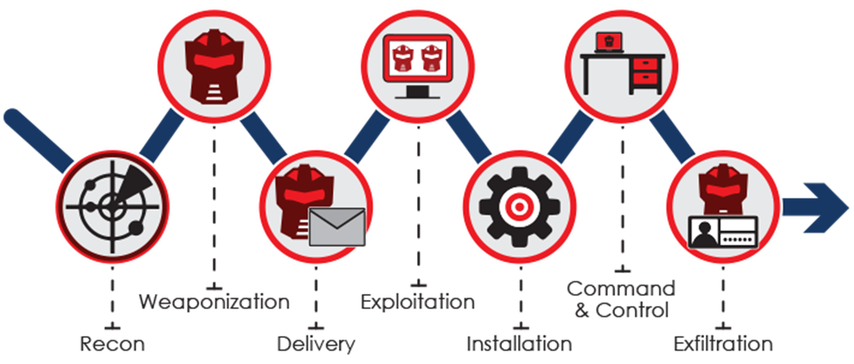
Typical Cyber Kill Chain Representation

Slide 7
So what is an Adversary simulation?

Slide 8
SynerComm’s Adversary Simulation
Based on pre-defined or customized playbook
Command and control, persistence, discovery and credential access
Privilege escalation and lateral movement
Collection and exfiltration
Defense evasion
Typically performed onsite in Cooperation with our client’s Team
Methodical, repeating process:
Attack > Validate Control > Improve Control > Validate Control > Next Attack
Tactics, techniques and procedures based on MITRE ATT&CK for Enterprise

Slide 9
MITRE Adversarial Attack Tactics

Slide 10
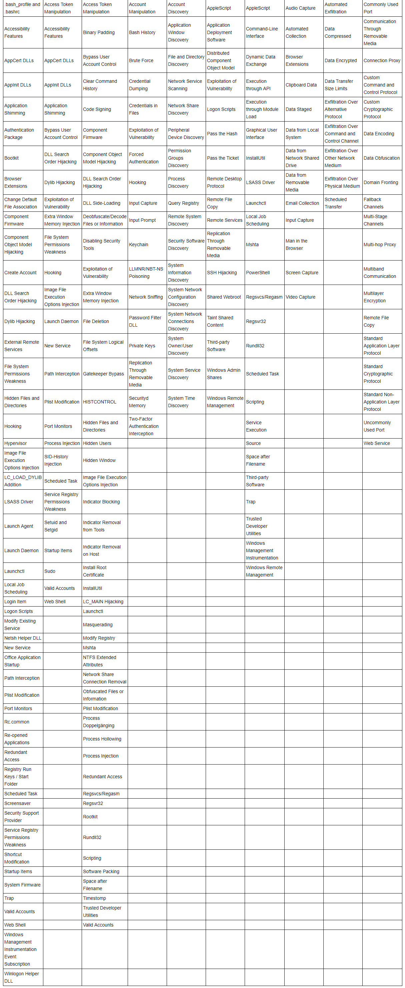
MITRE ATT&CK for Enterprise

Slide 11
Benefits of Adversary Simulation
Train and prepare IT, security and response staff
Validate, tune and improve control effectiveness
Enterprise focus is on SIEM collection and alerting

Slide 12
SynerComm’s AdSim Process
Scope High-Level Playbook
Consult to Define the Playbook
Execute the Playbook
Tune & Adjust Controls
Retest

Slide 13
SynerComm’s AdSim Process

Slide 14
SynerComm’s AdSim Process

Slide 15
Questions?
Thank You for Attending! Go Tell Your Friends

